Slide 1

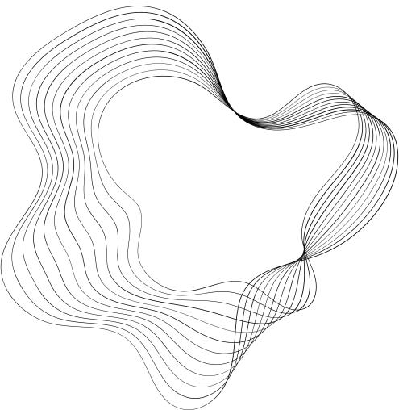
TECHNIQUES TO IMPLEMENT
LOAD BALANCING
IN NETWORKS
SUPERVISOR:
DR. P. SWETHA
Professor of CSE Department
PRESENTATION BY:
Tumre Prathima (20011P0522)
Marripelli Srija (20011P0513)

Slide 2

AGENDA
01
08
INTRODUCTION
CONCLUSION
02
09
MOTIVATION
REFERENCES
03
PROBLEM STATEMENT
04
OBJECTIVE
05
ARCHITECTURE
06
TECHNOLOGIES USED
07
IMPLEMENTATION

Slide 3

INTRODUCTION
Load balancing is the process of distributing incoming traffic across a group of servers, or backend resources, in a computer network, to optimize resource utilization, maximize throughput, minimize response time, and prevent overload.

Slide 4
MOTIVATION
A single server might struggle to handle the sudden surge in user traffic, leading to slow loading times or potential crashes.
Load balancing in this scenario distributes the incoming requests across multiple servers.
As a result, the website can effectively manage the increased load, ensuring faster response times and reduces the risk of server overload or downtime.

Slide 5
PROBLEM STATEMENT
Implementing load balancing algorithms to effectively redistribute the incoming traffic to the assigned servers. These algorithms include Round-Robin and Least Connections.

Slide 6
OBJECTIVE
The main objective of the project is to implement a load balancing solution that can optimize resource utilization, maximize throughput, minimize response time, and ensure high availability.

Slide 7
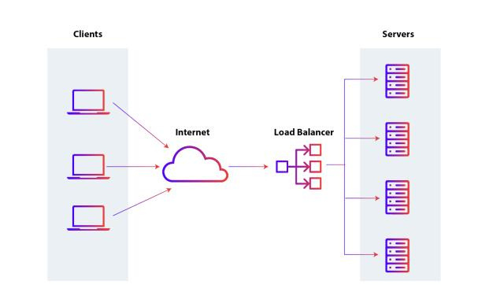
ARCHITECTURE

Slide 8
TECHNOLOGIES USED
Tools
Scripting Language
Environment
NS2 (Network Simulator)
NAM (Network Animator)
Virtual Box
TCL (Tool Command Language)
Ubuntu

Slide 9
IMPLEMENTATION
ROUND-ROBIN
Round Robin sequentially distributes incoming requests across a group of servers, ensuring that no single server becomes overburdened. This cyclic pattern ensures that each server contributes equally handling incoming traffic, efficiently minimizing latency and enhancing overall system responsiveness.

Slide 10
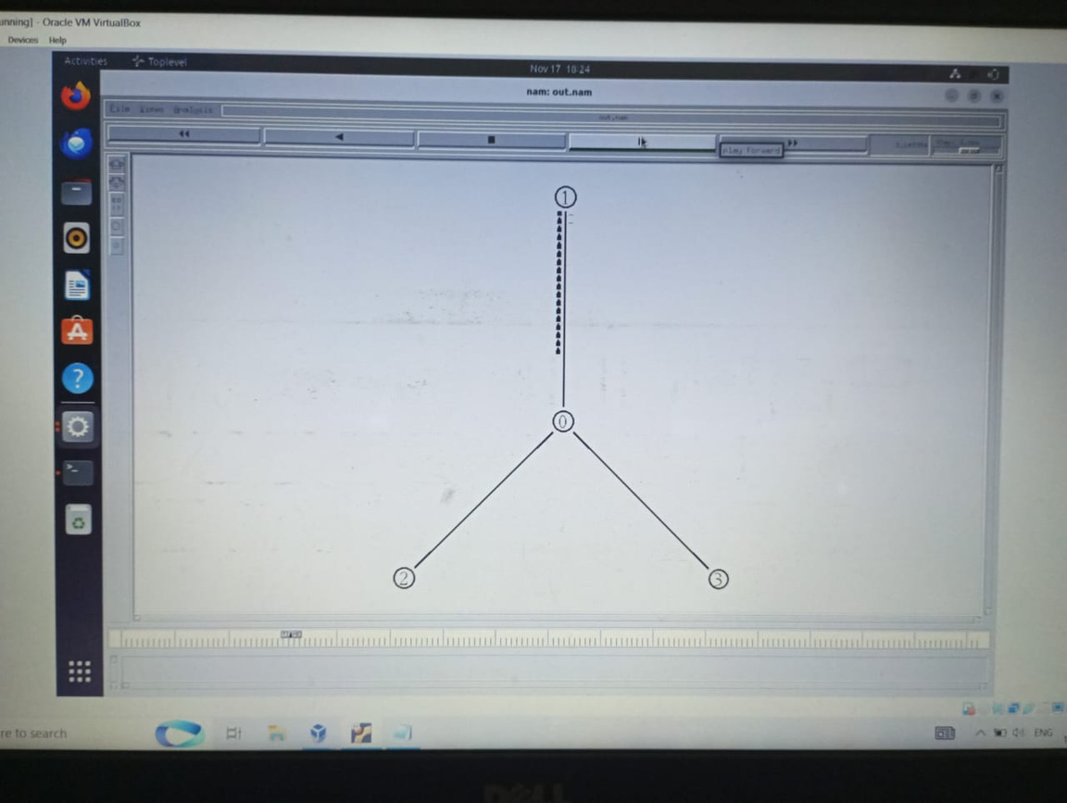
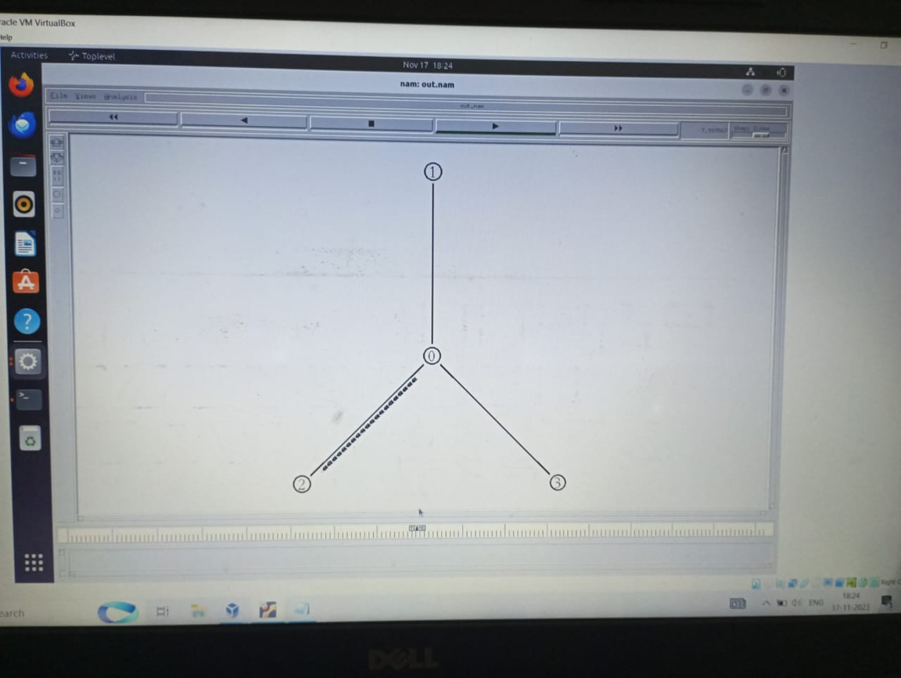
RESULTS
ROUND-ROBIN

Slide 11
IMPLEMENTATION
LEAST CONNECTIONS
Least Connections algorithm prioritizes lightly loaded servers. It actively monitors the current load of each server, directing incoming traffic to the server with the fewest active connections.

Slide 12
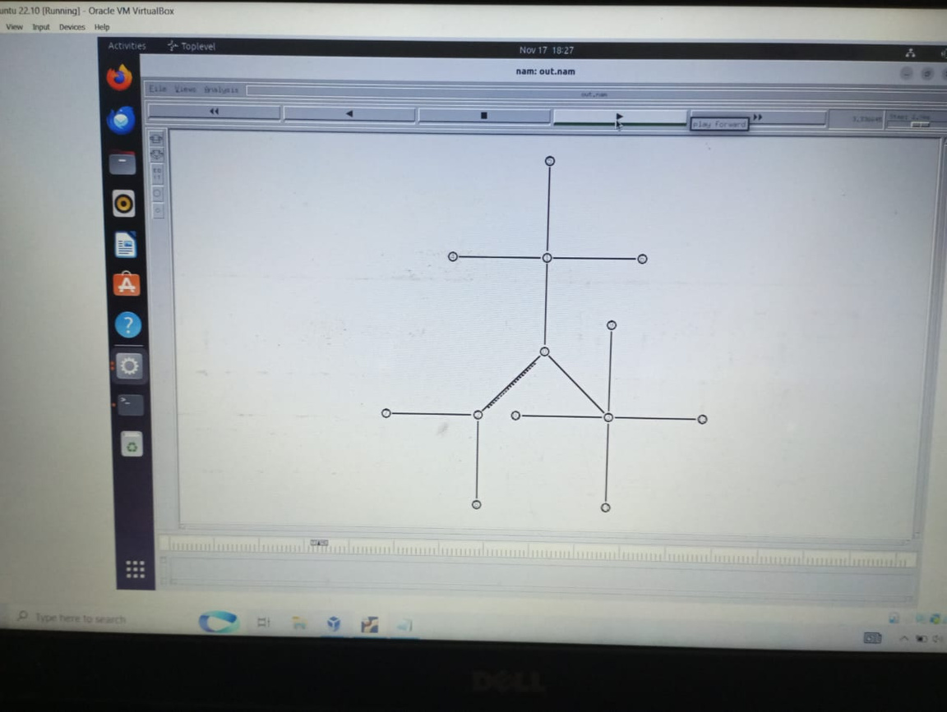
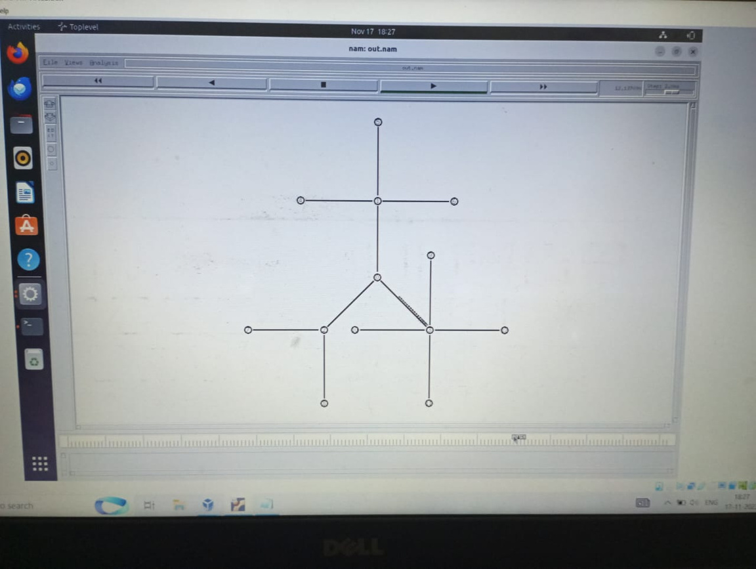
RESULTS
LEAST CONNECTIONS

Slide 13
CONCLUSION
In this project, we implemented two load balancing algorithms, round-robin and least connections, using the NS2 network simulator. From this project we came to a conclusion that least-connections algorithm takes into account the load on each server, whereas round-robin does not. As a result, least connections algorithm is able to distribute traffic more evenly across the avaliable servers, which leads to improved performance.

Slide 14

REFERENCES
Research paper references:
“Load Balancing Implementation in Software Defined Networks”
Nikolay S. Prodanov, Kamelia S. Nikolova1 and Dimitar K. Atamian
Load Balancing Approach for Finding Best Path in SDN by Sayali Patil, Department of Computer Engineering Sardar Patel Institute of Technology Mumbai, India email:sayalee.shinde@gmail.com

Slide 15

THANK YOU

